Slide 1

Project Title -
Seasonal Agriculture Performance Analysis
[Rakshita Manjunath Shetti
College Name-MVJ College of Engineering ]
AICTE STU ID :STU697afee31f08d1769668323

Slide 2

PROBLEM STATEMENT
Agricultural activities are influenced by seasonal variations in environmental conditions, farming practices, resource availability and market conditions. As a result, agricultural performance may differ from one season to another. However, raw agricultural data does not clearly explain how agricultural performance changes across seasons or what patterns can be observed in different seasonal conditions. The problem is to analyze the given agricultural dataset and investigate seasonal differences in agricultural performance by identifying meaningful patterns, trends, relationships and variations within the available data.

Slide 3
Project Description
This project analyzes Seasonal Agricultural Performance using agricultural data to understand how factors such as crop type, season, rainfall, temperature, irrigation, yield, production, water usage, and profit are related to farming performance. The project includes data cleaning, statistical analysis, and visualizations to identify patterns and seasonal differences. The findings help understand crop productivity and profitability and support better data-driven agricultural decision-making.

Slide 4

WHO ARE THE END USERS?
Farmers – To understand crop yield, seasonal performance, and profitability.
Agricultural Analysts – To analyze agricultural trends and identify important patterns.
Agricultural Organizations and Policymakers – To support data-driven agricultural
planning and decision-making.
Researchers and Students – To study relationships between environmental factors and
agricultural performance.

Slide 5

Technology Used
Python – Data analysis and processing
Pandas – Data cleaning and manipulation
NumPy – Numerical operations
Matplotlib – Data visualization
Seaborn – Statistical data visualization
Jupyter Notebook (.ipynb) in VS Code – Writing and executing the analysis code

Slide 6
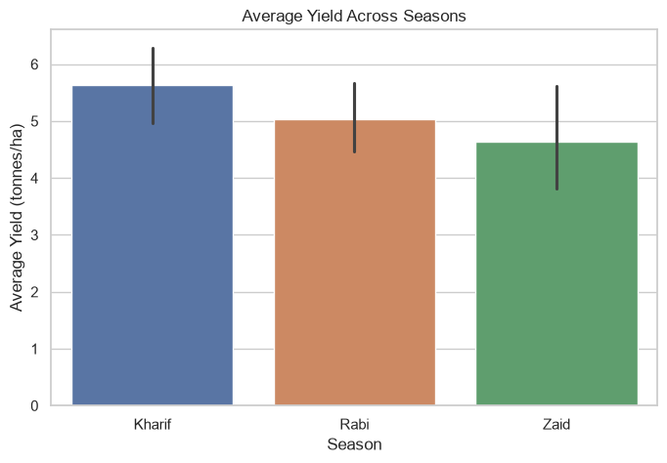
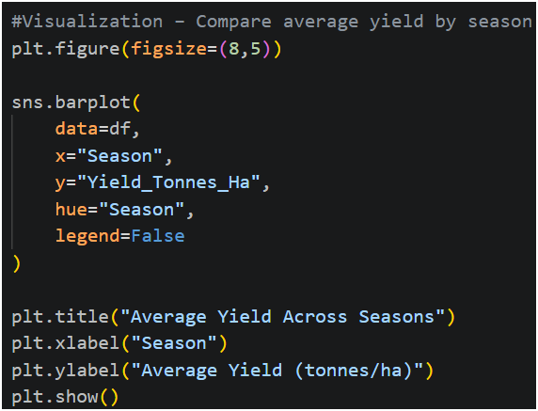
RESULTS
1. Average Yield Across Seasons
Explanation: Kharif showed the highest average yield, followed by Rabi and Zaid. This indicates that crop productivity varied across different seasons.

Slide 7
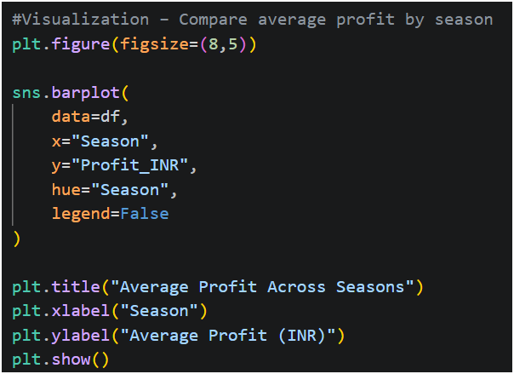
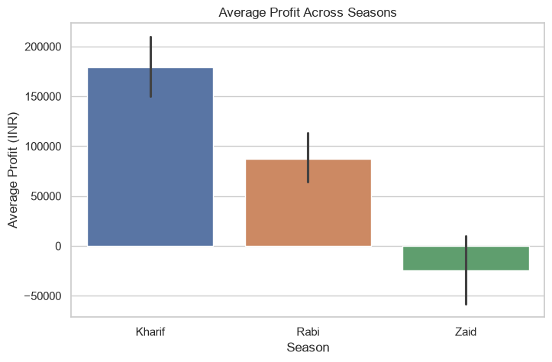
RESULTS
2. Average Profit Across Seasons
The graph compares the average profit across different seasons. It shows that profitability varies by season, with some seasons generating higher average profits than others. This analysis helps identify the seasonal differences in the economic performance of agriculture.

Slide 8
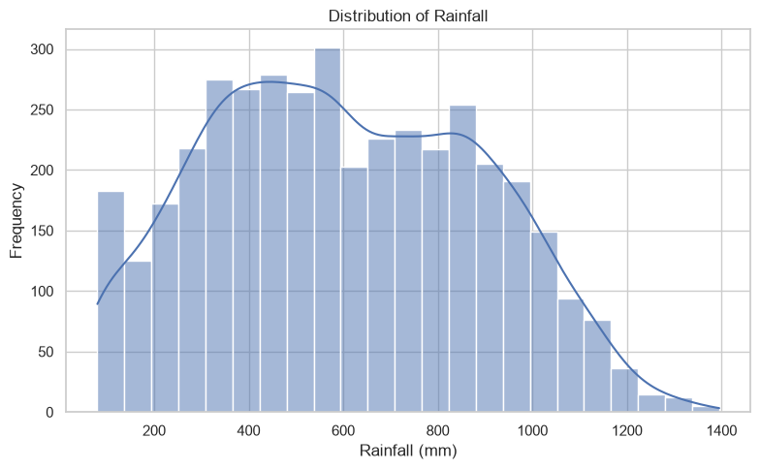
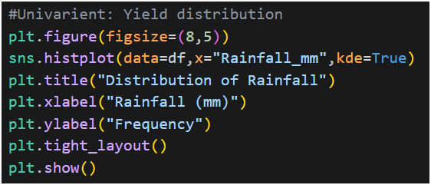
RESULTS
3. Rainfall Distribution:
This graph shows the distribution of rainfall values in the dataset. It helps understand how frequently different rainfall ranges occur and whether the rainfall data is concentrated around particular values or spread across a wide range.

Slide 9
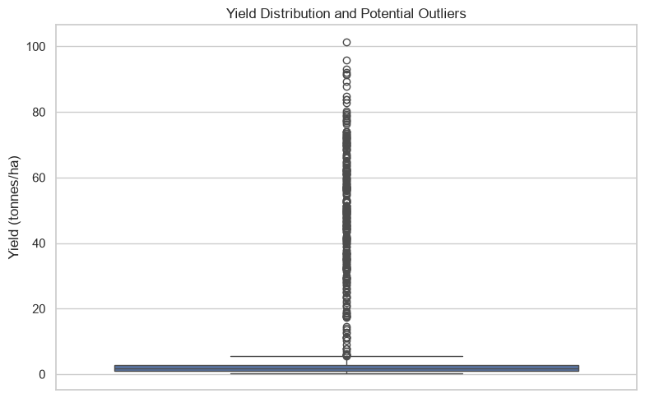
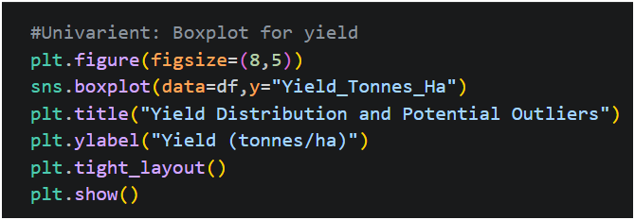
RESULTS
4. Yield Distribution and Potential Outliers:
This boxplot shows the distribution of crop yield and identifies potential outliers. The extreme values indicate that some farms have unusually high or low yields, showing variation in agricultural productivity.

Slide 10
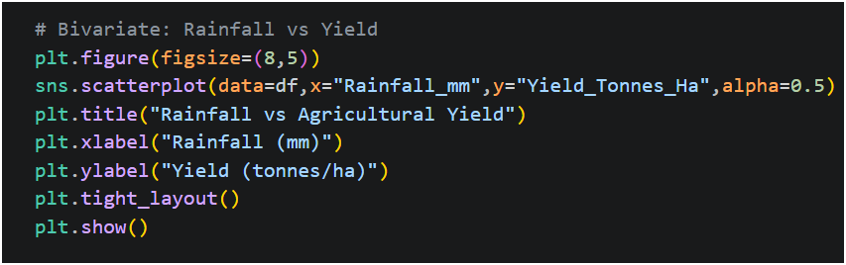
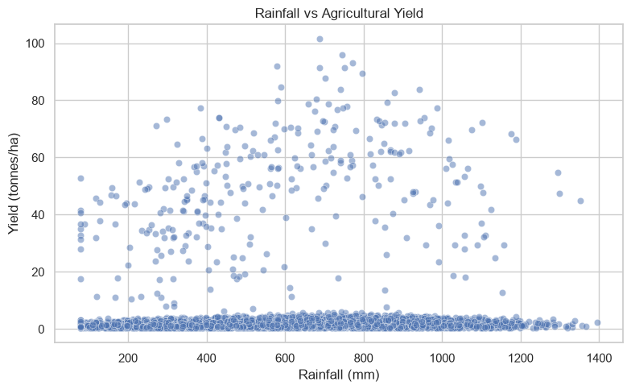
RESULTS
5. Rainfall vs Yield
Explanation: This graph shows the relationship between rainfall and crop yield. The distribution indicates that rainfall is one of the environmental factors associated with agricultural productivity.

Slide 11
Future scope
Use Machine Learning models to predict crop yield and profitability.
Include real-time weather and market price data for more accurate analysis.
Develop a web or mobile dashboard for farmers and agricultural organizations.
Analyze a larger dataset covering more regions, crops, and seasons.
Use the analysis to provide crop recommendations and water management suggestions.

Slide 12
GitHub Link
https://github.com/rakshitashetti32/Seasonal-Agricultural-Performance-Analysis

Slide 13
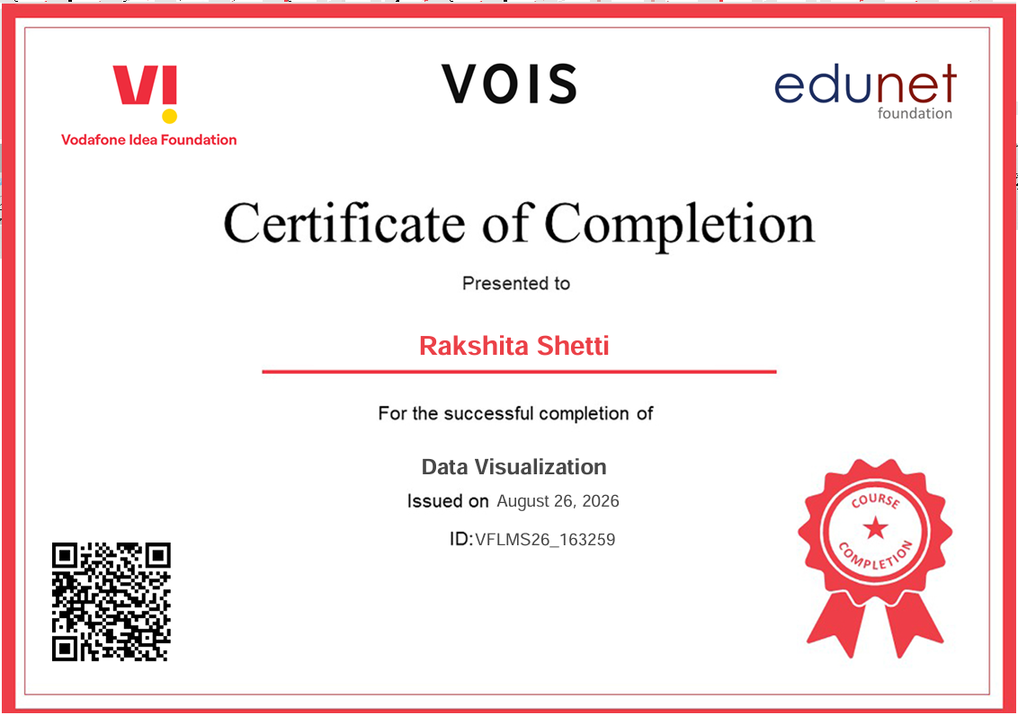
VOIS Course completion certificate - Course name- Data Visualization

Slide 14
Thank you
.
.

